Slide 1
The Pokemon Fight Simulator
A game by Felicia, Mathieu & Natan

Slide 2

The Game
Designed by Pokemon Fans for Gaming Fans
Turned-based game built in Python for an awesome XP
Pick a Pokemon.
Choose Your Attacks.
Make your way to Victory.

Slide 3

The Challenges
Going from Spagheti to Crystal clear pieces of code
Properly define & integrate lists into attack functions
Debug the minute mistakes that prevented the program from running

Slide 4
The Process
Discovering Jira and breaking down tasks
Adapting game rules and principles to pseudocode
Actually defining the elements we needed to set in place in order to bring the game to reality
Define the proper variables and functions
Bring those pieces of code together and debug
Twitch and improve user XP

Slide 5
Highlights Of the Game
Randomly Defined AI attacks
We made it ourselves !
Bring the User back to childhood
Succeed in properly setting Input

Slide 6
Rules Of the Game
Pick a Pokemon
Get ready
Pick Your Attacks
“Great Success”

Slide 7
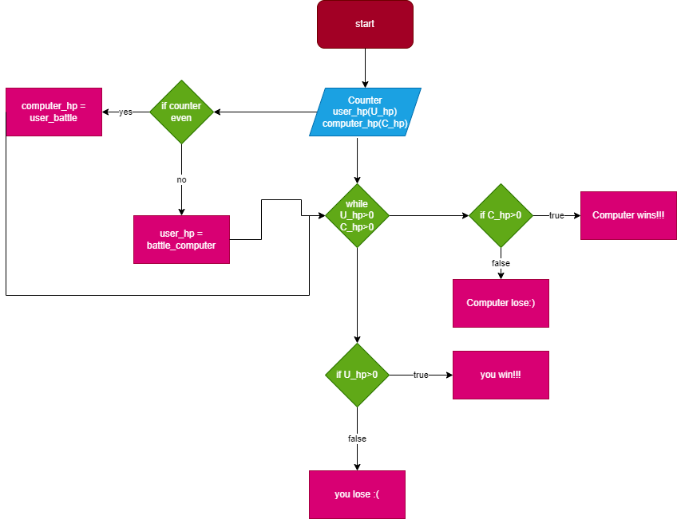

Slide 8
import random
Charizard = {'Flamethrower' : 25, 'Fly' : 20, 'Blast Burn' : 22, 'Fire Punch' : 16}
Blastoise = {'Water Gun' : 16, 'Bubblebeam' : 20, 'Hydro Pump' : 22, 'Surf' : 25}
Venusaur = {'Vine Wip' : 19, 'Razor Leaf' : 24, 'Earthquake' : 28, 'Frenzy Plant' : 22}
pokemons = [Charizard,Blastoise,Venusaur]
user_hp = 100
computer_hp = 100
user_list = []
computer_list = []
choice = int(input("For Charizard press 1, For Blastoise press 2, For Venusaur press 3 "))
if choice == 1:
user_pokemon = Charizard
elif choice == 2:
user_pokemon = Blastoise
else:
user_pokemon = Venusaur
computer_pokemon = random.choice(pokemons)
for i in user_pokemon.keys():
user_list.append(i)
attack1 = user_list[0]
attack2 = user_list[1]
attack3 = user_list[2]
attack4 = user_list[3]
for i in computer_pokemon.keys():
computer_list.append(i)
def battle_computer(x,c):
computer_turn_attack = random.choice(c)
computer_turn_attack_value = computer_pokemon.get(computer_turn_attack)
z = x - computer_turn_attack_value
return z
def user_battle(x,c):
turn_input = int(input(f"For {attack1} press 1, for {attack2} press 2, for {attack3} press 3, for {attack4} press 4"))
if turn_input == 1:
turn_attack = c[0]
elif turn_input == 2:
turn_attack = c[1]
elif turn_input == 3:
turn_attack = c[2]
elif turn_input == 4:
turn_attack = c[3]
turn_attack_value = user_pokemon.get(turn_attack)
z = x - turn_attack_value
return z
def end_of_turn(x,y):
print("Your current hp is: ",x)
print("Computer current hp is: ",y)
return
counter = random.randint(1,4)
while user_hp > 0 and computer_hp > 0:
if counter%2 == 0:
computer_hp = user_battle(computer_hp,user_list)
end_of_turn(user_hp,computer_hp)
else:
user_hp = battle_computer(user_hp,computer_list)
end_of_turn(user_hp,computer_hp)
counter += 1
if user_hp > 0:
print("You win")
else:
print("You lose")

